Slide 1

Are Housing Prices in US Affected by
Median Income, Population Density and Temperature?

Slide 2
Data collection approach (Housing price)
Initially ran a Zillow API to collect housing price but was limited based on parameters Zillow required (Needed address and/or Zillow ID).
Second approach was to use Zillow data from Kaggle.com, but ran into limitations on the number of states available (Only had OR and CA data)
Finally, collected Zillow mean data from Zillow.com based on two and three bedroom houses along with their respective zip codes.
We then converted zip codes to latitude and longitude to get a visualization of the continental US map

Slide 3
Data collection approach (Variables)
Population density and median income were collected from Census.gov and merged based on zip codes.
Temperature information was obtained in Open weather API and merged with latitude and longitude.

Slide 4
Motivation and Questions
As we all now live in a bubble of the Bay Area, the team wanted a better perspective of the variables that affect housing prices in a more macro point of view. Having found multiple points of data previously described, we ask the following questions:
Does median income effect housing prices within a zipcode?
Does higher population density increase housing prices?
Are people more prone to purchasing houses with optimal temperatures?

Slide 5
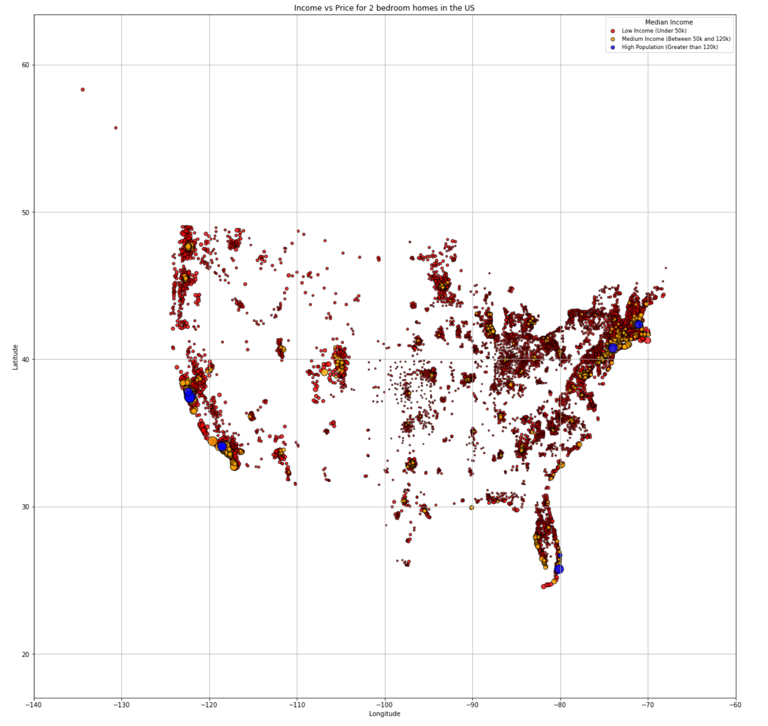
Median Income vs 2 Bedroom Housing Prices
Correlation between higher median income vs. housing prices.
Low income group (less than $50k):
- 87% houses cost < $200k
- 11% houses cost >=$200k and <=500k
- 1% houses cost > $500k
Median Income between ($50k and $125k)
- 58% houses cost < $200k
- 35% houses cost >=$200k and <=500k
- 7% houses cost > $500k
High Income greater than $120k
- 6% houses cost < $200k
- 47% houses cost >=$200k and <=500k
- 48% houses cost > $500k

Slide 6
Median Income vs 3 Bedroom Housing Prices
Correlation between higher median income vs. housing prices.
Low income group (less than $50k):
- 80% houses cost < $200k
- 18% houses cost >=$200k and <=500k
- 2% houses cost > $500k
Median Income between ($50k and $125k)
- 40% houses cost < $200k
- 49% houses cost >=$200k and <=500k
- 11% houses cost > $500k
High Income greater than $120k
- 0% houses cost < $200k
- 42% houses cost >=$200k and <=500k
- 58% houses cost > $500k

Slide 7
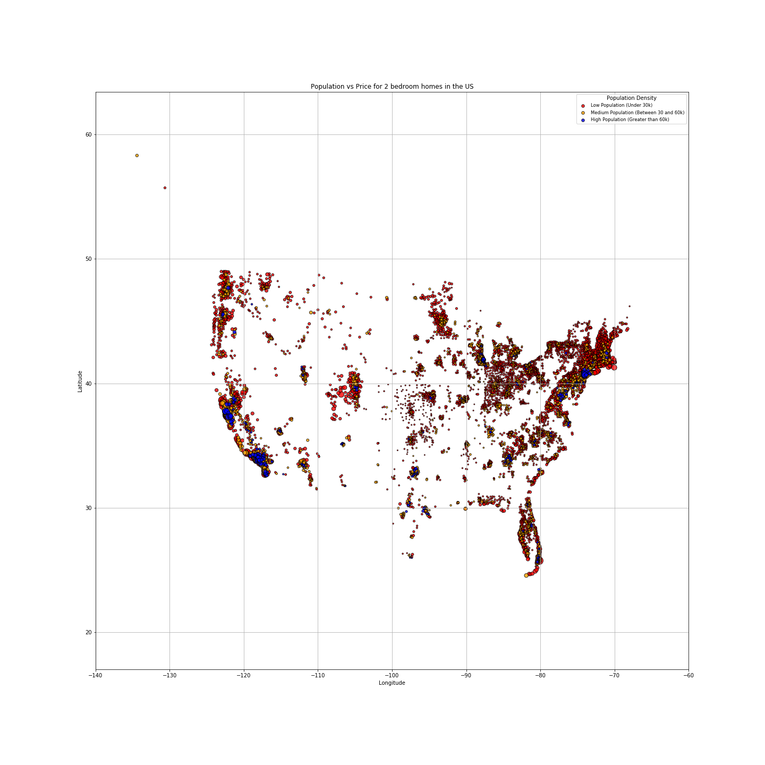
Which picture is worth $1,000 words?
US Map
Line Graph

Slide 8
Population Density vs Housing Price- 2 BR

Slide 9
Population Density vs Housing Price- 3 BR

Slide 10

Have you ever asked yourself, Is there any relationship between housing priceS and the weather?
If we have good weather means the housing price is higher?

Slide 11
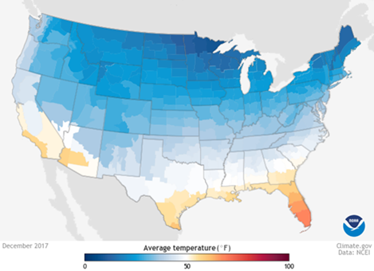
Initially consider to get the historical weather data from NOAA climate.gov but the problem was you should download .csv file zip code by zip code
Second approach was to use open weather historical data file, but that was not free
Finally, collected the daily weather data from open weather.com based on 3000 random collection of the zip codes.

Slide 12
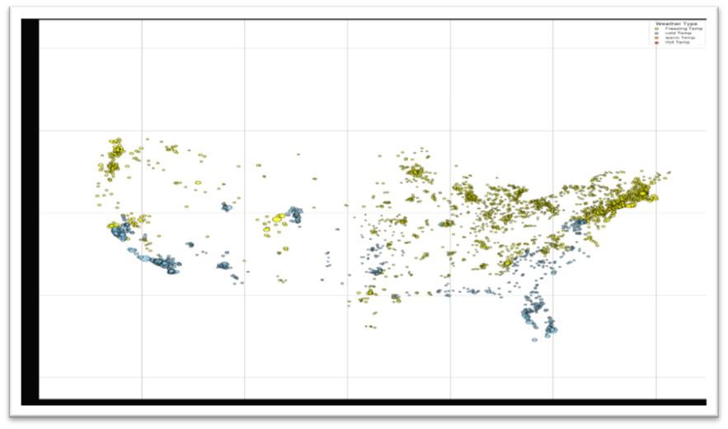
Correlation between Temperature vs. housing prices.
Freezing area(temp less 0 ):
- 75% houses cost < $200k
- 23% houses cost >=$200k and <=500k
- 2% houses cost > $500k
Cold area(0<temp<10)
- 57% houses cost < $200k
- 40% houses cost >=$200k and <=500k
- 3% houses cost > $500k
Warm area (10<temp<20)
- 18% houses cost < $200k
- 54% houses cost >=$200k and <=500k
- 28% houses cost > $500k
Hot area (temp>20)
- 11% houses cost < $200k
- 47% houses cost >=$200k and <=500k
- 42% houses cost > $500k

Slide 13

Post Mortem
Finding the right BIG data SPECIALLY when you consider to merge with other set of data is a challenge.
The question that we would like to tackle, if we had A few more days, is the relationship between housing prices and their Proximity to the coastlines.

